Slide 1

Web Development

Slide 2
Agenda & Overview
Introduction to the Internet and Websites
What is HTML
Learning CSS
How does JS work

Slide 3

So What is the Internet?

Slide 4


Slide 5
What is the Internet?
A whole load of information and data
Shared across a network of computers
Stored in the form of a website

Slide 6

So What is a Website?

Slide 7
What is a Website?
The page that you see in your web browser
A collection of interrelated pages
Each page is a hypertext document that is connected to the internet

Slide 8
What makes a Website
Hypertext Document
Coded Using HTML
(Hypertext Mark-up Language)
File Extension: .Html

Slide 9

What makes a Website look nice?
CSS (Cascading Style Sheets)
Style, Look and Feel
Design of the Page
Animations

Slide 10

What makes a Website look nice?
JS (Javascript)
Interaction
Cool Effects
Examples: animation, sliders, etc

Slide 11
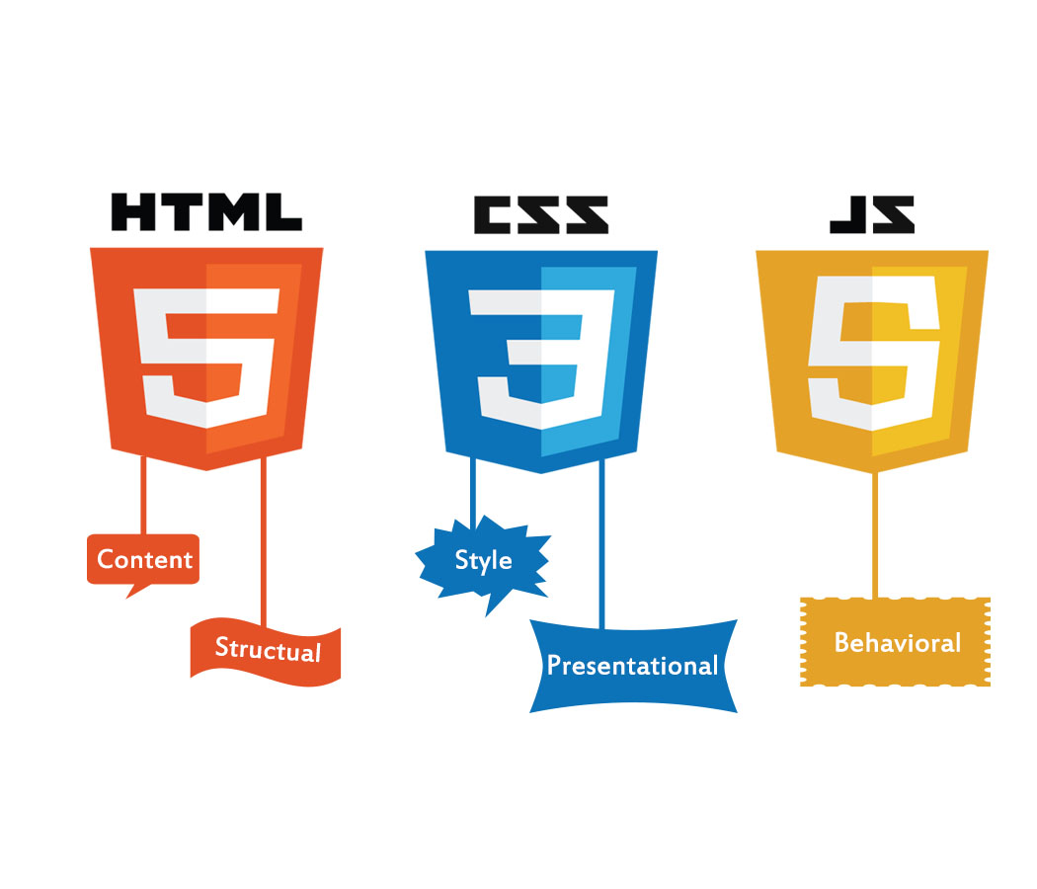
What is a Website?

Slide 12

HTML

Slide 13
HTML – HyperText Markup Language
Markup Language(Different from a programming language)
Utilize tags to define the layout, structure and content of any web page
Markup language is read by the browser which then renders the website on your screen

Slide 14
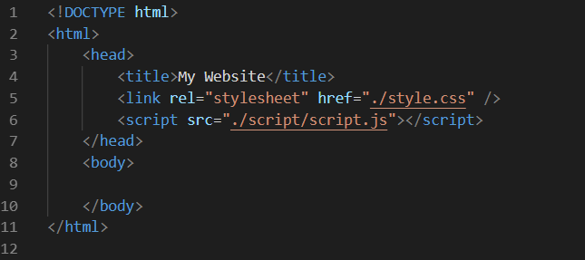
Structure
Head
Container for metadata (data about data)
Webpage’s Title
Linking of CSS and JS files
Information not to be displayed on the webpage

Slide 15
Structure
Body
Container for the visible content on a webpage
Part of HTML that is rendered/displayed on your browser

Slide 16
HTML Elements
Building blocks of a html page
Represented by tags like:
<head></head>
<body></body>
Consists of an opening and closing tag

Slide 17
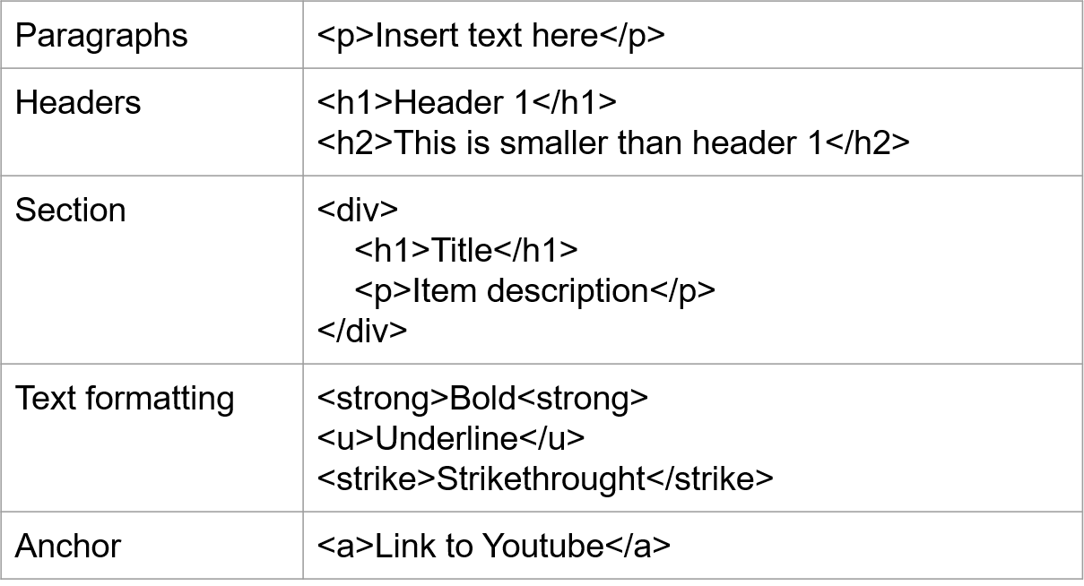
HTML Elements

Slide 18
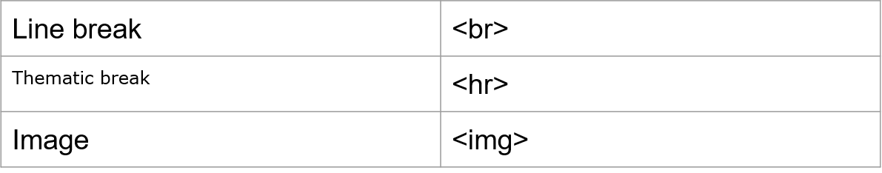
HTML single Tag Elements
Have no content inside

Slide 19
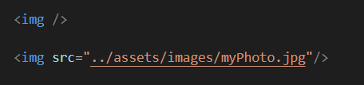

HTML Element Attributes
Properties/Settings of the tag
Provides additional information for the element
Not all element share the same attributes but there are some universal ones

Slide 20
Global Attributes
Id
A unique name or index given to a HTML element
Used for styling or Javascript manipulation
Style
Used to style the HTML element inline.
Class
Used to style the HTML element with a CSS class

Slide 21
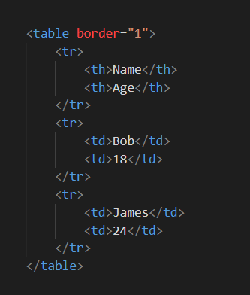
Tables
Name | Age
Bob | 18
James | 24
<table></table>
Used to define a table
<tr></tr>
Used to define a table row
<td><td>
Used to define a table cell

Slide 22
Exercise

Slide 23

CSS

Slide 24
CSS – Cascading Style Sheet
Describes how an HTML element is to be styled
The Web Browsers apply CSS rules to the HTML elements
CSS rules are formed from:
Selector - Pointer to which element
Rules - A Set of Properties and values

Slide 25
Writing CSS
Inline
Written along with the HTML using element attributes
Internal CSS files
Included and written in the <head> of an html page using <style> tag
External CSS files
Linked in the <head> of an html page
Notes:
1. Inline style (highest priority)
2. Internal style sheet (second priority)
3. External style sheet (third priority)

Slide 26
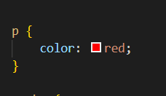
CSS Syntax
Selector
Rule
Property
value

Slide 27
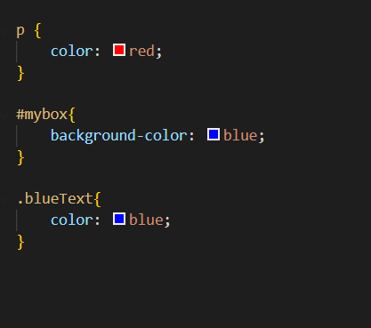
Writing CSS
Tag styling
Applies for all tags
Id styling
Apply to single elements
Class styling
Reusable

Slide 28
CSS Rules – Text Formatting
color: specify color of the text
Values: color names, hex values or rgb values
E.g. red, #FFFFFF, rgb(255,0,0)
text-align: specify horizontal alignment of texts
Values: left, right, center, justified
text-decoration: add/remove text decoration
Values: overline, underline, line-through

Slide 29
CSS Rules – Font Properties
font-family: changes font type for text
Values: monospace, cursive
font-style
Values: normal, italic
font-size:
Values: 15px, 20px

Slide 30
Background Properties
background-color: specifies the background color of an element
Background-image: specifies the background image of an element
Values: url of an image either locally or online
E.g. url(“myPicture.png”)

Slide 31
Box and Sizing Properties
width & height:
Values: 100px, 100vw, 100vh, 10%

Slide 32
Box Model
Margin: specifies space around the element
margin: 10px;
margin: 10px 15px;
margin: 10 15px 5px 20px;
Border: specifies a border around the element
border: 1px solid black;
border: 2px dotted red;
Padding: specifies space around the element’s content
padding: 5px;
padding: 15px 10px;

Slide 33
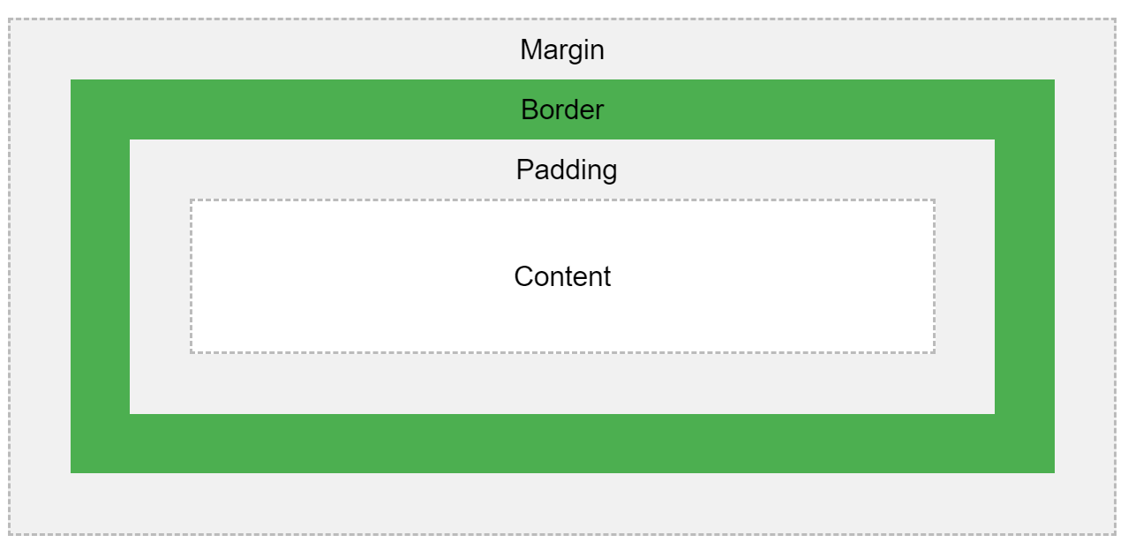
Box Model

Slide 34
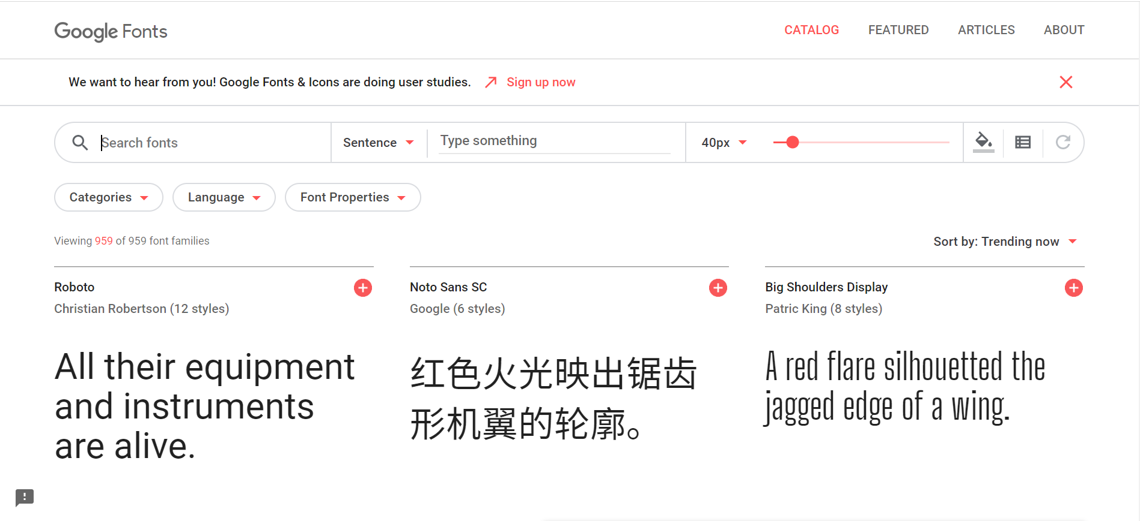
Google Fonts
https://fonts.google.com/
Provides a huge library of fonts
Notes:
https://fonts.google.com/

Slide 35
CSS Framework – Font Awesome
Iconic Font and CSS Framework
Customised font for your webpages
Thousands of icons to choose from

Slide 36

How to use Font Awesome
Using the CDN(Content Delivery Network)
Include link reference to the resource
Find desired icons on website
Add to HTML pages using class attributes
Notes:
https://fontawesome.com/

Slide 37

JavaScript

Slide 38
JavaScript
A Programming Language
JavaScript can update and change both HTML and CSS
JavaScript can calculate, manipulate and validate data

Slide 39
Where is JS files & how to include them
Similar to CSS
External JavaScript
Linked in the <head> of a HTML file
Internal JavaScript
Written directly in HTML files
Enclosed with <script></script> tags
JavaScript is normally placed in body segments
Order of importing/including of JavaScript library matters

Slide 40
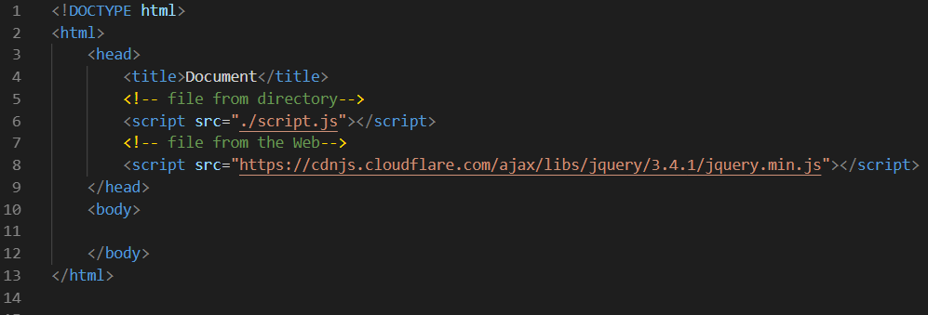
External JavaScript
Import a script file with .js extension
Can be referenced from an external source. Similar to CDN
User <script> tag to include the js file

Slide 41
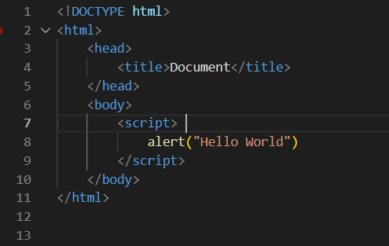
Internal JavaScript
Written within the HTML
Enclosed with <script> tags

Slide 42
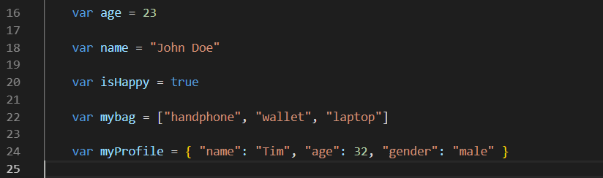
Variable Syntax
Declare variable using var
Variable are used to store values/information

Slide 43
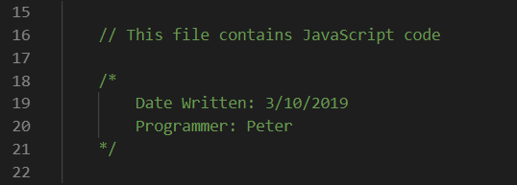


JavaScript Output & Feedback
Script Comments
Comments for developers to read
Single line Comments
Multi-line Comments
Print/Write to Console for debugging
Pop up alerts

Slide 44
JavaScript – Manipulating HTML Elements
Finding HTML elements
By Element id
document.getElementById(“outputbox”)
By Class name
document.getElementsByClassName(“red-box”)
By Tag name
document.getElementsByTagName(“p”)
“Document” refers to the current HTML document

Slide 45
Examples to get started

Slide 46
JavaScript Library - JQuery
Fast, small, and feature-rich JavaScript library.
Simplifies HTML manipulation, animations and data retrieval
“Write less, achieve more”

Slide 47
How to use JQuery
Similar to FontAwesome
Using the CDN(Content Delivery Network)
Include script reference to the resource
Notes:
https://code.jquery.com/
CDN (include in HTML head):
<script src="https://code.jquery.com/jquery-3.4.1.js" integrity="sha256-WpOohJOqMqqyKL9FccASB9O0KwACQJpFTUBLTYOVvVU=" crossorigin="anonymous"></script>

Slide 48
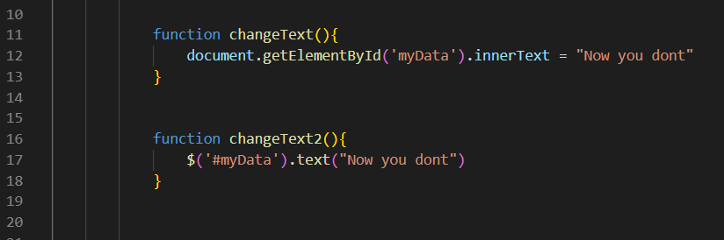
Before vs JQuery

Slide 49
JSON & API

Slide 50
What is an API

Slide 51

What is an API

Slide 52
What is JSON

Slide 53
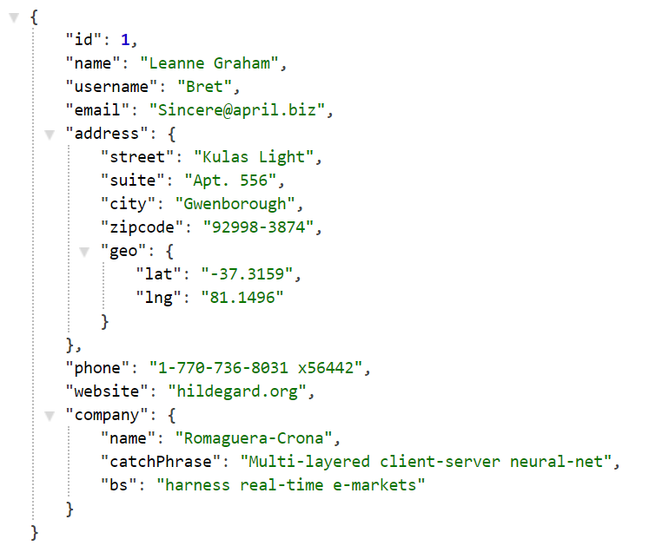
What is JSON
Lightweight data-interchange format for storing and exchanging data online
When exchanging data over the internet, the data can only be text
Notes:
https://jsonplaceholder.typicode.com/users/1

Slide 54
How to retrieve data from an API
Using Jquery built-in functions
Send a request to website
Retrieve its data and display it on our website

Slide 55
Exercise

